Slide 1
LOGIN SYSTEM FINAL PROJECT
MADE BY: KUTMAN ESHENKULOV

Slide 2
TABLE OF CONTENTS
1.
4.
2.
5.
3.
6.
ABOUT THE PROJECT
SOME FEATURES
Here you could describe the topic of the section
Here you could describe the topic of the section
SCREENSHOTS
BIBLIOGRAPHY
Here you could describe the topic of the section
Here you could describe the topic of the section
HOW IT WORKS
CONCLUSION
Here you could describe the topic of the section
Here you could describe the topic of the section

Slide 3

ABOUT THE PROJECT
Login system is a software which is helpful for college as well as school authorities. It help university student to log in to their personal pages. This project made with python 3 and Tkinter module. It stands out with simplicity of code and easy to use.

Slide 4
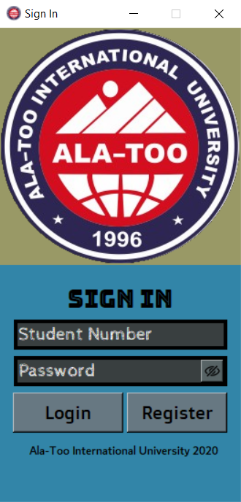
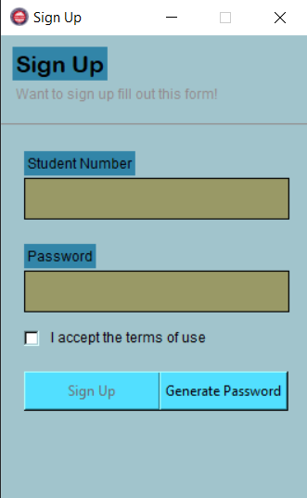
SCREENSHOTS
SIGN IN
SIGN UP

Slide 5
HOW IT WORKS
INCORRECT
LOGIN WINDOW
CORRECT
SUCCES WINDOW
USERNAME
PASSWORD
IF VALID
REGISTER
USERNAME
PASSWORD
IF INVALID
Demonstrating steps

Slide 6
SOME FEATURES
TITLE
LOGO OF APP
LOGO OF APP
TITLE
SIGN UP LABEL
LOGO OF ALATOO UNIVERSITY
STUDENT NUMBER
ENTY
PASSWORD ENTRY
CHEK BUTTON
SIGN IN LABEL
PASSWORD GENERATOR BUTTON
STUDENT NUMBER ENTY
PASSWORD ENTRY
HIDE\SHOW
BUTTON
LOGIN BUTTON
SIGN IN BUTTON

Slide 7

BIBLIOGRAPHY
VIDEO
GITHUB
TUTORIAL

Slide 8

CONCLUSION
Undoubtedly, this project was completed with great difficulty and a lot of time. The project was a good learning experience for me. I got knowledge and ideas in programming, as well as visual Python. Throughout the development phase of a project, I came face to face with practical programming aspects that can help me develop professional projects in the near future.

Slide 9
THANKS!
DO YOU HAVE ANY QUESTION?

